Slide 1
Elasticity of demand
Dr. Jalandhar Pradhan
Reference: Karl E. Case, Ray C. Fair and Sharon M. Oster: Principles of Economics, Pearson Publisher

Slide 2
ELASTICITY
elasticity A general concept used to quantify the response in one variable when another variable changes.

Slide 3
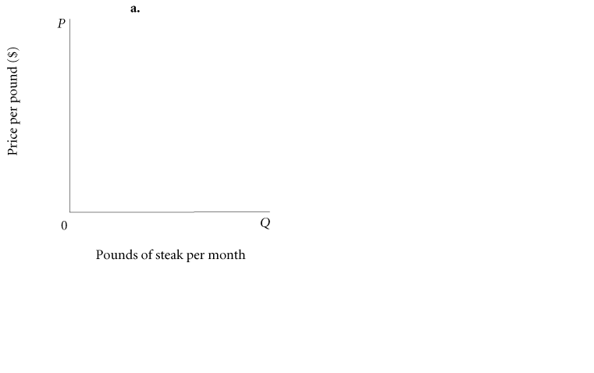
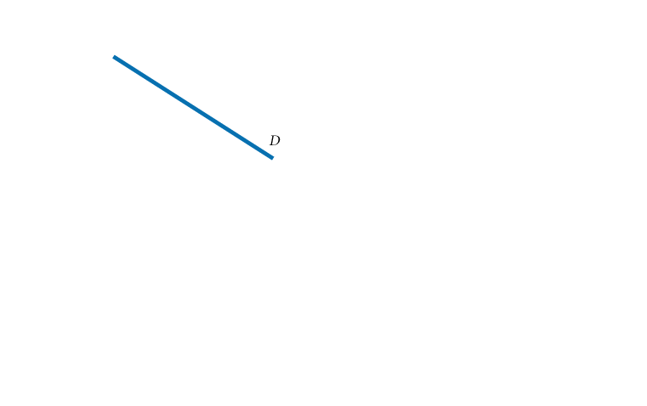
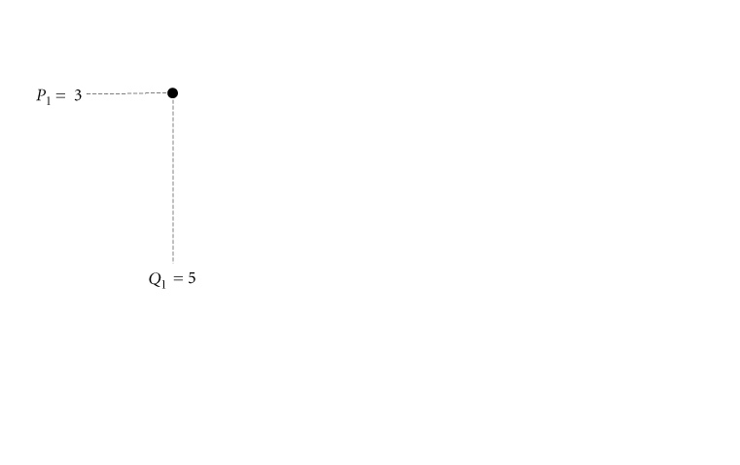
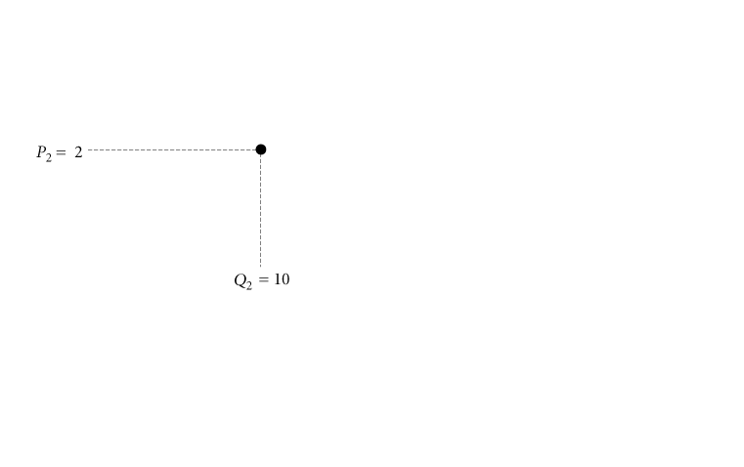
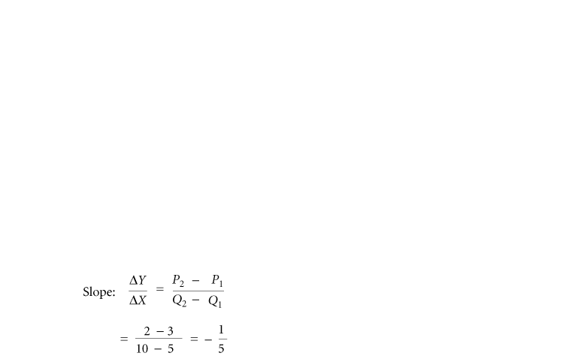
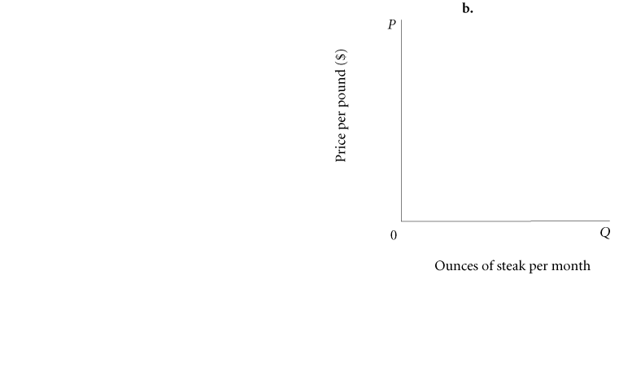
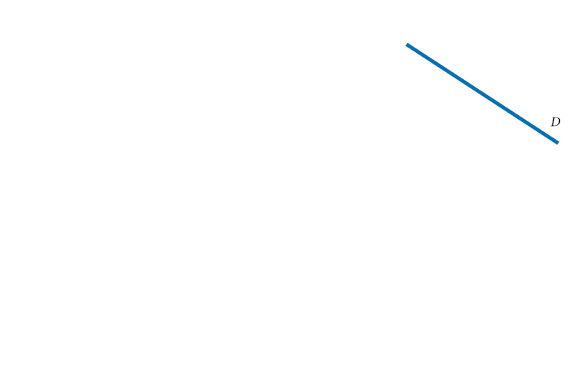
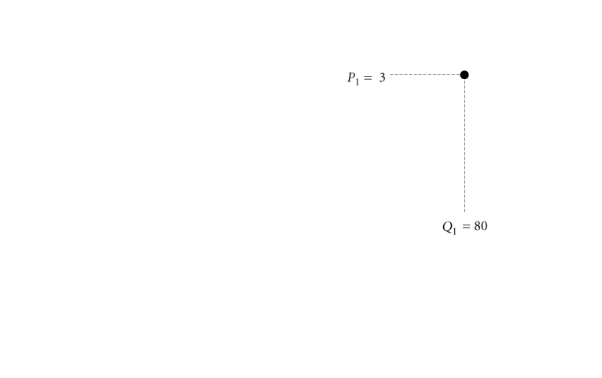
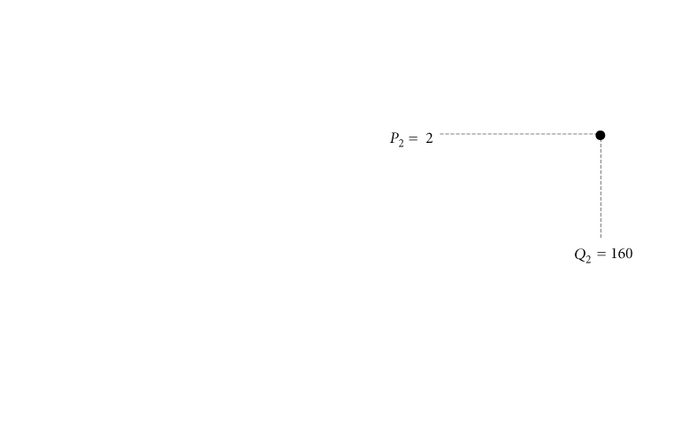
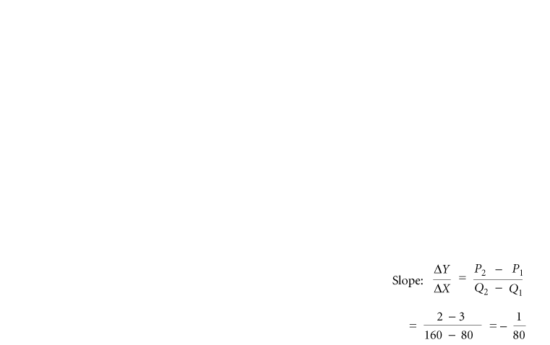
PRICE ELASTICITY OF DEMAND
SLOPE AND ELASTICITY
FIGURE 1 Slope Is Not a Useful Measure of Responsiveness

Slide 4
PRICE ELASTICITY OF DEMAND
price elasticity of demand The ratio of the percentage of change in quantity
demanded to the percentage of change in price; measures the responsiveness of demand to changes in price.

Slide 5
PRICE ELASTICITY OF DEMAND
TYPES OF ELASTICITY
TABLE 1 Hypothetical Demand Elasticities for Four Products
PRODUCT | % CHANGE INPRICE (% ΔP) | % CHANGE IN QUANTITY DEMANDED (% ΔQ_{D}) | ELASTICITY (% ΔQ_{D} ÷ %ΔP)
Insulin | +10% | 0% | 0.0 |  | Perfectly inelastic
Basic telephone service | +10% | -1% | -0.1 |  | Inelastic
Beef | +10% | -10% | -1.0 |  | Unitarily elastic
Bananas | +10% | -30% | -3.0 |  | Elastic
perfectly inelastic demand Demand in which quantity demanded does not respond at all to a change in price.

Slide 6
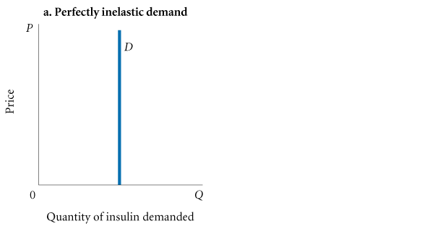
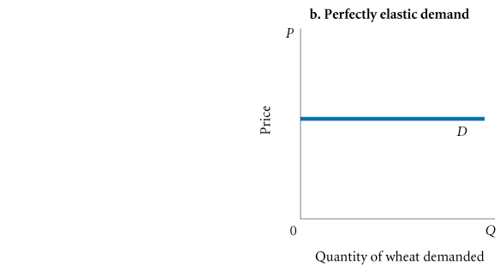
PRICE ELASTICITY OF DEMAND
FIGURE 2 Perfectly Elastic and Perfectly Inelastic Demand Curves
inelastic demand Demand that responds somewhat, but not a great deal, to changes in price. Inelastic demand always has a numerical value between zero and -1.

Slide 7
PRICE ELASTICITY OF DEMAND
A warning: You must be very careful about signs. Because it is generally understood
that demand elasticities are negative (demand curves have a negative slope), they are
often reported and discussed without the negative sign. For example, a technical paper
might report that the demand for housing “appears to be inelastic with respect to price,
or less than 1 (0.6).” What the writer means is that the estimated elasticity is -.6, which
is between zero and -1. Its absolute value is less than 1.
unitary elasticity A demand relationship in which the percentage change in quantity of a product demanded is the same as the percentage change in price in absolute value (a demand elasticity of -1).

Slide 8
PRICE ELASTICITY OF DEMAND
elastic demand A demand relationship in which the percentage change in quantity demanded is larger in absolute value than the percentage
change in price (a demand elasticity
with an absolute value greater than 1).
perfectly elastic demand Demand in which quantity drops to zero at the
slightest increase in price.

Slide 9
PRICE ELASTICITY OF DEMAND
A good way to remember the difference between the two “perfect” elasticities is:

Slide 10
CALCULATING ELASTICITIES
CALCULATING PERCENTAGE CHANGES
To calculate percentage change in quantity demanded using the initial value as the base, the following formula is used:

Slide 11
CALCULATING ELASTICITIES
We can calculate the percentage change in price in a similar way. Once again, let us use the initial value of P—that is, P₁—as the base for calculating the percentage. By using P₁ as the base, the formula for calculating the percentage of change in P is simply:

Slide 12
CALCULATING ELASTICITIES
ELASTICITY IS A RATIO OF PERCENTAGES
Once all the changes in quantity demanded and price have been converted into percentages, calculating elasticity is a matter of simple division. Recall the formal definition of elasticity:

Slide 13
CALCULATING ELASTICITIES
THE MIDPOINT FORMULA
midpoint formula A more precise way of calculating percentages using the value halfway between P₁ and P₂ for the base in
calculating the percentage change in price, and the value halfway between Q₁ and Q₂ as the base for calculating the percentage
change in quantity demanded.

Slide 14
CALCULATING ELASTICITIES
Using the point halfway between P₁ and P₂ as the base for calculating the percentage change in price, we get

Slide 15
CALCULATING ELASTICITIES
TABLE 2 Calculating Price Elasticity with the Midpoint Formula
First, Calculate Percentage Change in Quantity Demanded (%ΔQ_{D}):
By substituting the numbers from Figure 5.1(a): | PRICE ELASTICITY COMPARES THE PERCENTAGE CHANGE IN QUANTITY DEMANDED AND THE PERCENTAGE CHANGE IN PRICE: DEMAND IS ELASTIC
Next, Calculate Percentage Change in Price (%ΔP):
By substituting the numbers from Figure 5.1(a):

Slide 16
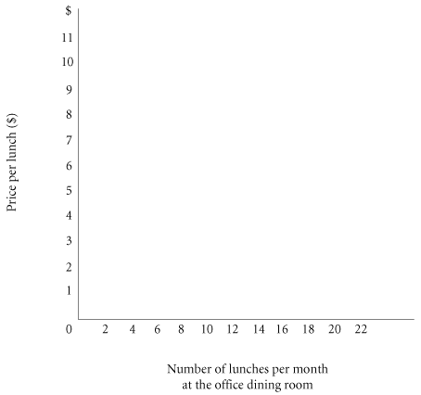
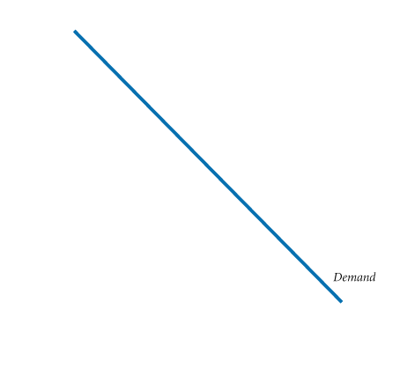
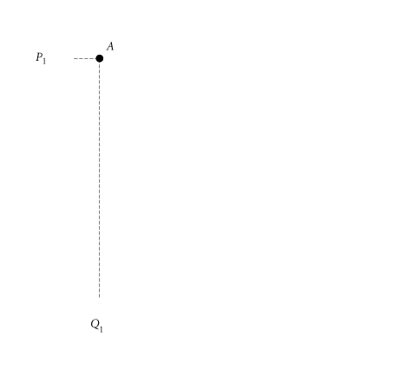
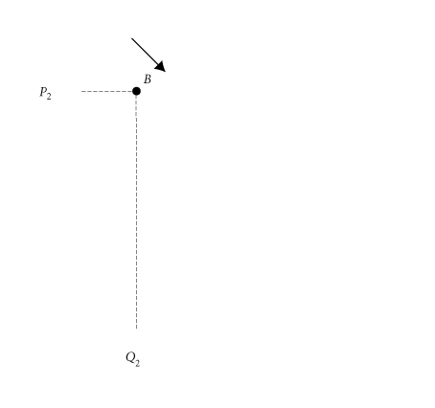
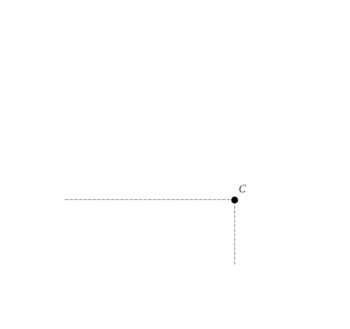
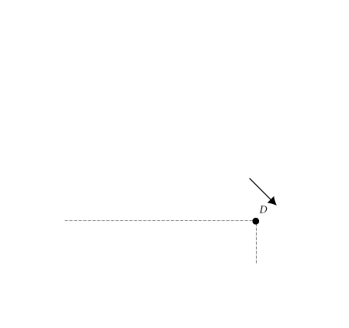
CALCULATING ELASTICITIES
ELASTICITY CHANGES ALONG A STRAIGHT-LINE DEMAND CURVE
TABLE 3 Demand Schedule for Office Dining Room Lunches
PRICE (PER LUNCH) | QUANTITY DEMANDED (LUNCHES PER MONTH)
$11 10 9 8 7 6 5 4 3 2 1 0 | 0 2 4 6 8 10 12 14 16 18 20 22
FIGURE 3 Demand Curve for Lunch at the Office Dining Room

Slide 17
CALCULATING ELASTICITIES
ELASTICITY AND TOTAL REVENUE
In any market, P x Q is total revenue (TR) received by producers:
TR = P x Q total revenue = price x quantity
When price (P) declines, quantity demanded (Q_{D}) increases. The two factors, P and Q_{D}, move in opposite directions:
Effects of price changes on quantity demanded:

Slide 18
CALCULATING ELASTICITIES
Because total revenue is the product of P and Q, whether TR rises or falls in response to a price increase depends on which is bigger, the percentage increase in price or the percentage decrease in quantity demanded.
Effects of price increase on a product with inelastic demand:
If the percentage decline in quantity demanded following a price increase is larger than the percentage increase in price, total revenue will fall.
Effects of price increase on a product with inelastic demand:

Slide 19
CALCULATING ELASTICITIES
The opposite is true for a price cut. When demand is elastic, a cut in price increases total revenues:
effect of price cut on a product
with elastic demand:
When demand is inelastic, a cut in price reduces total revenues:
effect of price cut on a product
with inelastic demand:

Slide 20
THE DETERMINANTS OF DEMAND ELASTICITY
AVAILABILITY OF SUBSTITUTES
Perhaps the most obvious factor affecting demand elasticity is the availability of substitutes.
THE IMPORTANCE OF BEING UNIMPORTANT
When an item represents a relatively small part of our total budget, we tend to pay little attention to its price.
THE TIME DIMENSION
The elasticity of demand in the short run may be very different from the elasticity of
demand in the long run. In the longer run, demand is likely to become more elastic, or
responsive, simply because households make adjustments over time and producers
develop substitute goods.

Slide 21
OTHER IMPORTANT ELASTICITIES
INCOME ELASTICITY OF DEMAND
income elasticity of demand Measures the responsiveness of demand to changes in income.

Slide 22
OTHER IMPORTANT ELASTICITIES
CROSS-PRICE ELASTICITY OF DEMAND
cross-price elasticity of demand A measure of the response of the quantity of one good demanded to a change in the price of another good.

Slide 23
OTHER IMPORTANT ELASTICITIES
ELASTICITY OF SUPPLY
elasticity of supply A measure of the response of quantity of a good supplied to a change in price of that good. Likely to be positive in output markets.

Slide 24
OTHER IMPORTANT ELASTICITIES
elasticity of labor supply A measure of the
response of labor supplied to a change in the price of labor.

Slide 25
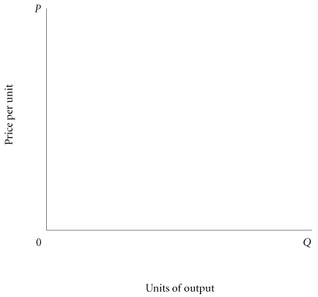
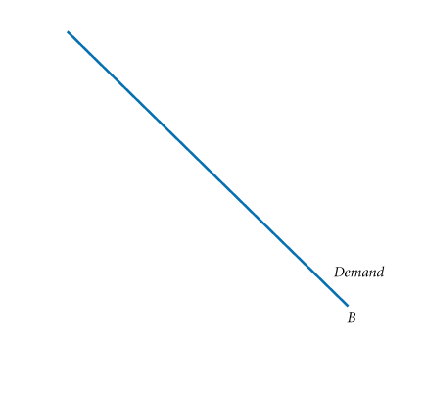
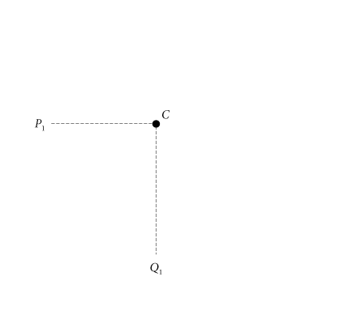
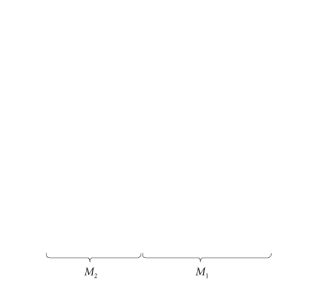
Appendix
POINT ELASTICITY (OPTIONAL)
FIGURE 3 Elasticity at a Point Along a Demand Curve
Consider the straight-line demand curve in Figure 3. We can write an expression for elasticity at point C as follows:

Slide 26
Appendix
ΔQ/ΔP is the reciprocal of the slope of the curve. To calculate the reciprocal of the slope to plug into the electricity equation, we take Q₁B, or M₁, and divide by minus the length of line segment CQ₁. Thus,
Since the length of CQ₁ is equal to P₁, we can write:
By substituting we get:

Slide 27
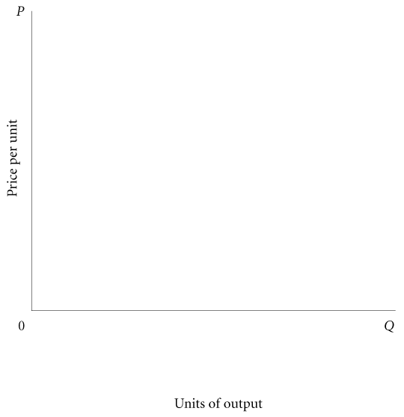
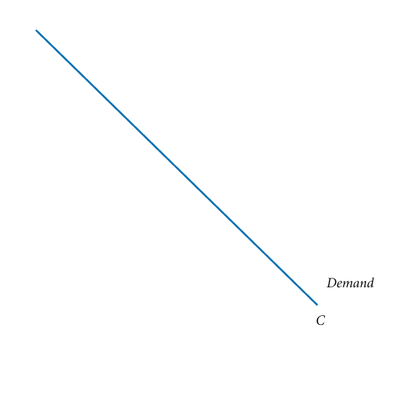
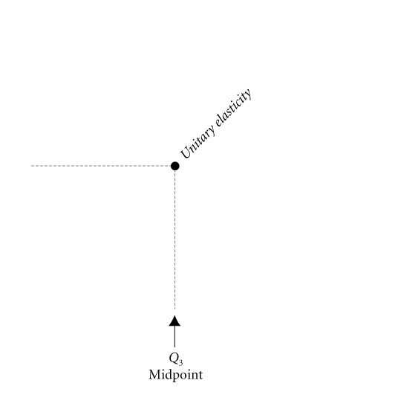
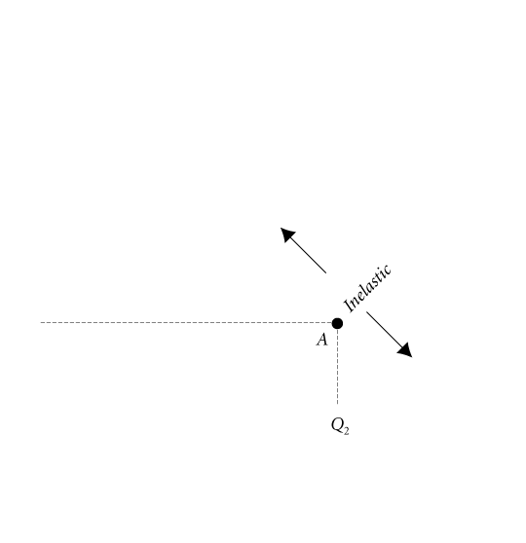
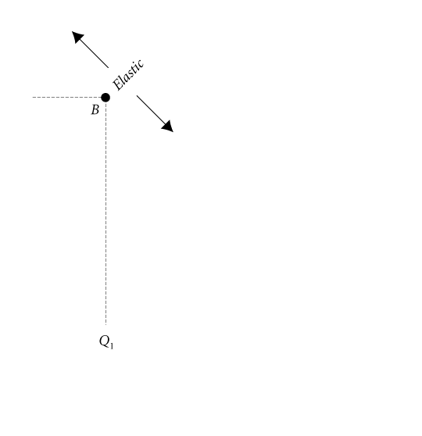
Appendix
FIGURE 4 Point Elasticity Changes
Along a Demand Curve

